Slide 1
Ski Data Modleing Report
Big Mountain Resort
Director of Operations, Jimmy Blackburn
Database Manager, Alesha Eisen
Guided Capstone Project 1
Shawn Fang
07/24/2021

Slide 2
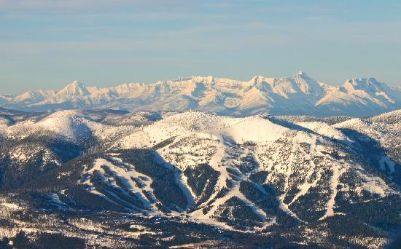
Problem Identification
In what ways would Big Mountain Resort be able to capitalize on their current facilities through price adjustments or cost cutting to reflect the resorts best ticket value?
Introduction
Big Mountain Resort is visited by 350,000 skiing/snowboarding customers annually. This year, having recently installed a new lift to improve visitor distribution, Big Mountain saw increases in their operating cost by $1,540,000 this season. Already pricing higher than average, management is seeking to optimize the pricing in order to draw the most visitors, but not having to lower their price point to the market average.

Slide 3
Problem Identification Cont.
Criteria for success
Complete evaluation of ski data provided by Big Mountain through modeling and predict scenario that would capitalize on Big Mountain’s ticket valuable.
Scope of solution space
Scope includes features that are realistically adjustable by management such as increasing or decreasing runs, trams, snow making and etc.

Slide 4
Recommendations and Key Findings
Key Findings
Modelled price for Big Mountain is $95.87 while current tickets are priced at $81.00
State data has no obvious correlations to ticket pricing
Most influential features affecting price variation
From Linear Regression: fastQuads, Snow Making_ac, vertical_drop, total chairs
From Random Forest: fastQuads, Runs, Snow Making_ac, vertical_drop
Verticle drop had the biggest influence with ticket value.
Cutting runs results in some negative influence to ticket value.
Recommendations
Increasing price to at least $85.48. Potential considerations include a combination of increasing vertical drop through adding lifts and decreasing a predetermined number of runs to further improve ticket value.

Slide 5
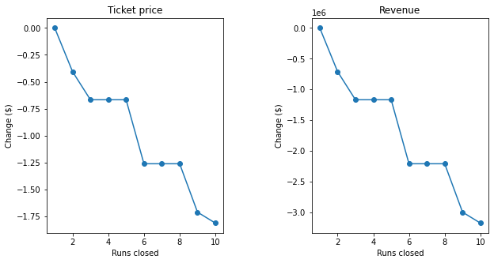
Modeling Results and Analysis
Results
Big Mountain Resort modelled price is $95.87, compared to the actual price of $81.00.
The expected mean absolute error is $10.39, which suggests there is room for an increase.
Utilizing the modeling, we tested 4 scenarios.
Scenario 1 Permanently closing down up to 10 of the least used runs.
Results show that closing 1 run makes no difference to ticket price nor revenue, however 2-3 will cause a drop. between 4 to 5 runs there is no effect. After 6 there will be significant drop.

Slide 6
Modeling Results and Analysis
Scenario 2 Increase the vertical drop by 150 ft.
In this scenario, we added an additional run that is 150 ft long adding to the base of the lowest lift. In addition we will needed to add another lift to the model.
Results show that by adding a run to increase the vertical drop, model supports an increase to ticket prices by $8.61.
Scenario 3 Increase the vertical drop by 150 ft. and increase snow making by 2 acres.
For this model, we used the same parameters as Scenario 2, however we increased the snowmaking by 2 acres.
Results show that including the extra snow making will only increase the ticket price by another $1.30 and is not a significant increase.

Slide 7
Modeling Results and Analysis
Scenario 4 Increase the longest runs 0.2 miles, including 4 extra acres of snow making.
In the modeling, we adjusted the longest run by +0.2 miles in addition to increasing the snow making to 4 acres.
Results show that increasing the longest run and snowmaking did no effect to the value of ticket
The scenario’s indicate that slight adjustments to some features such as vertical drop and number of runs would have significant impact to the ticket value. Other features such as longest run and snow making, although were indicated as influential features, they didn’t make as much impact as the prior.

Slide 8
Summary and Conclusion
In what ways would Big Mountain Resort be able to capitalize on their current facilities through price adjustments or cost cutting to reflect the resorts best ticket value?
Considering the information from the scenario modeling, Big Mountain Resort will be able to capitalize on their current facilities by adjusting their price higher, supported by the models regarding where their facilities place them in accordance to the rest of the resorts in the United States. In addition, Big Mountain Resort can utilize the model to plan for future investment strategies suggested in the analysis to improve further their

